Slide 1
LDA Topic clustering on national miner health and safety data
Exploring Topic Modelling in Data Narrative Fields
Luke Sturgeon

Slide 2
Presentation Overview
Project Scope and Deliverables
Process Overview
LDA Explanation in Context
Topic Selection
Machine Learning Techniques on Selected Observations
Conclusions
Future Work/To Do’s

Slide 3
Project Scope
CDC is interested in how fatigue impacts miner safety and health
Accident, Injury, Illness data
Continually updated, federally enforced, very large
Narratives fields may be best method to detect fatigue
Hasten the process with machine learning techniques
Explore any trends within the selected reports
Explore predictive model efficacy

Slide 4
Process overview
Data pre-processing
01
Topic Modelling using LDA model
02
Topic Selection
03
Trend Analysis and Predictive Modelling
04

Slide 5
Data pre-processing
Accident, Injury, Illness (AII) data is large
300,000 x 57, roughly 17M cells
Selecting injury reports from surface coal
Smallest subset of data based on mine type
Use smallest dataset to prove process before repeating on other mine types
9438 x 57, roughly 530,000 cells

Slide 6
Topic Modelling
“topicmodel,” “tidytext,” and “tm” packages in R
Narrative fields vectorized using “tm” package
Latent Dirichlet allocation (LDA)
Considers each document a mixture of topics
Considers each topic as a mixture of words
Allows documents to overlap between topics
More natural representation of language representation
Number of topics is specified, k=100 for this project
Returns matrix of each document’s proportion belonging to a topic

Slide 7
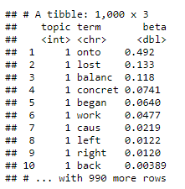
Topic Modelling word-Topic probability
Calculate per-topic-per-word probabilities
Probability that the given word will appear in a given topic
Shown here is the table of the 10 most probable words within each topic
Shown as “beta” in tibble

Slide 8
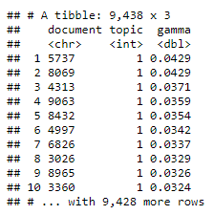
Topic Modelling document-topic probability
Calculate per-document-per-topic probabilities
The proportion of each document belonging to each topic
Computationally burdensome (5+ hours for this subset of data)
Tibble shows which topic has the largest proportion of words within narrative

Slide 9
Topic Selection
Topics were selected by term frequency
The words with the highest probability of belonging to only one topic, used the most often within each document
These reports are a squirrely bunch
Safety officers and the miners involved have incentive to attribute error to process
Fatigue is hard to pick out since “sleep,” “fatigue,” “nap time” were never used in the dataset
I checked
Fatigue leads people to use heuristics rather than consider all factors when making decisions
I pulled topics that had words involving judgements and decision making
“investigate,” “decide,” “judge” e.g.
Out of 9,438 observations

Slide 10
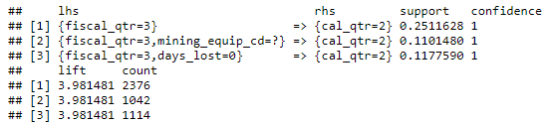
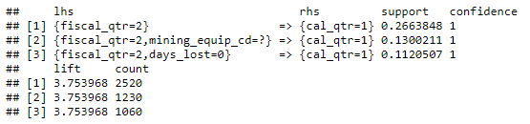
Association
Narrative fields are one column out of 57 within AII
Now that we have suspected fatigue related observations, can see if we can predict other variables from the rest of the data
Use association to pick out variables that are associated with each other due to redundancy

Slide 11
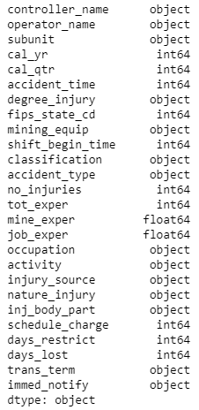
Association Data reduction
The final dataset variables
Greatly reduced the dataset from the original
Now working with 812 x 26 dataset
Process will be repeated for underground coal, underground hard rock, and surface hard rock

Slide 12
Predictive modelling classification
Interested in being able to predict miner experience and if days work were lost
Dummy coded the variables for classification
“tot_exper” = 0,1 by less than/greater than 5 years experience, respectively
“days_lost” = 1,0 if worker missed work or not, respectively
Categorical variables were dummy coded as well
Final dataset size 0f 818 x 926

Slide 13

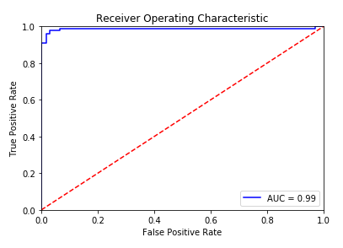
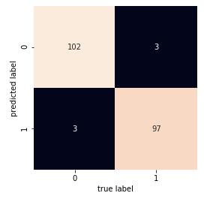
Predictive modelling Logistic regression, days lost

Slide 14
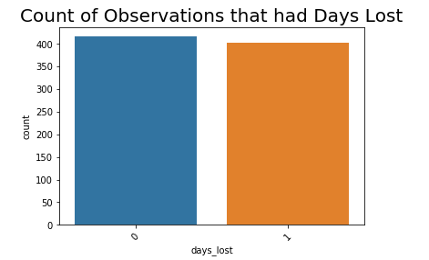
Predictive modelling logistic regression, miner experience
With such a robust ROC curve, I figured this was too obvious of a variable
Perhaps almost all of the observations resulted in days lost or vice versa
Count data shows it’s more interesting than that
Continue with this for the rest of the analysis

Slide 15

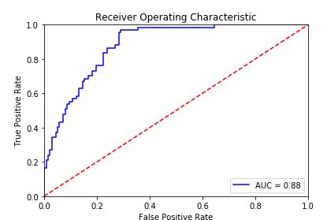
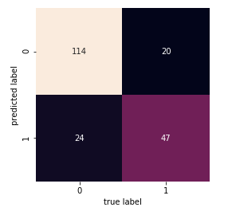
Predictive modelling logistic regression, miner experience

Slide 16
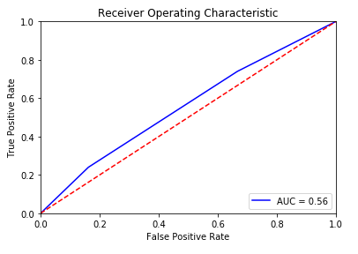
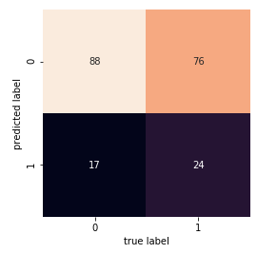
Predictive modelling knn, days lost

Slide 17
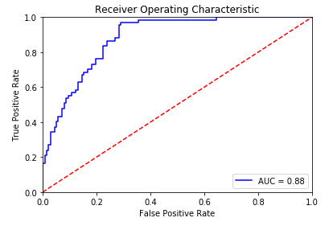
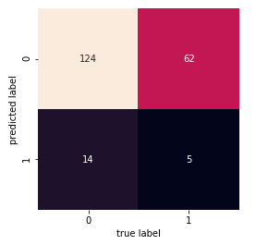
Predictive modelling knn, miner experience

Slide 18
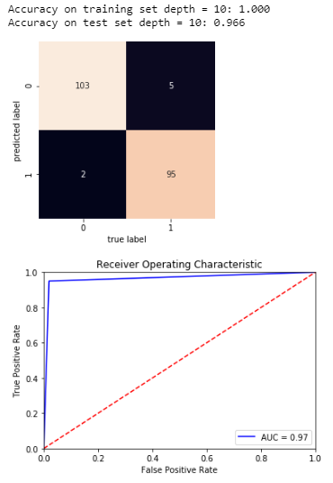
Predictive modelling simple Tree, days lost

Slide 19
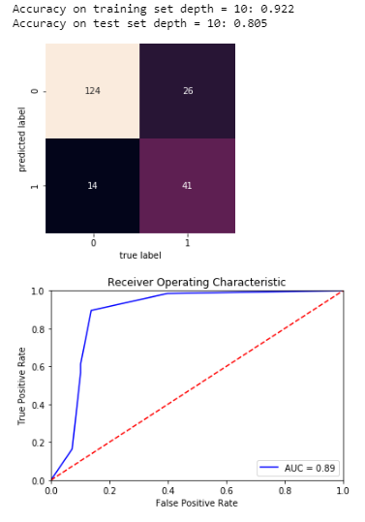
Predictive modelling simple Tree, miner experience

Slide 20
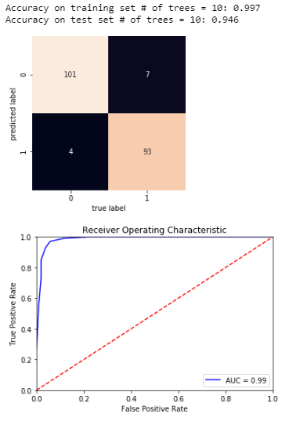
Predictive modelling Random forest, days lost

Slide 21
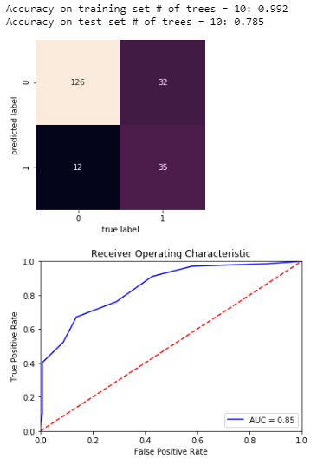
Predictive modelling Random forest, miner experience

Slide 22
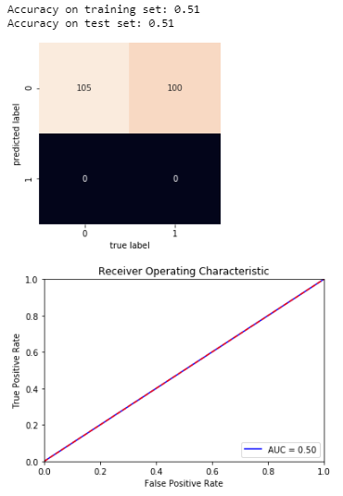
Predictive modelling neural network, days lost

Slide 23
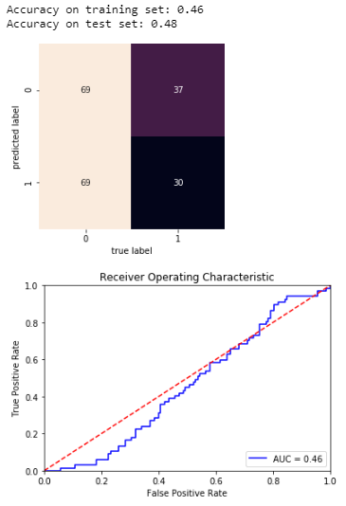
Predictive modelling neural network, miner experience

Slide 24
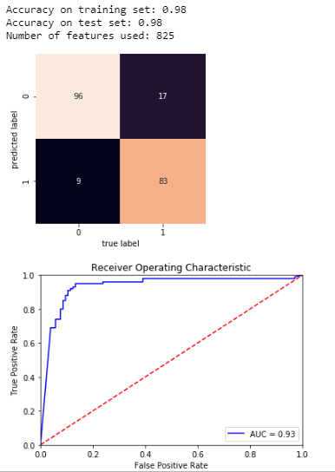
Predictive modelling gaussian naïve-bayes, days lost

Slide 25
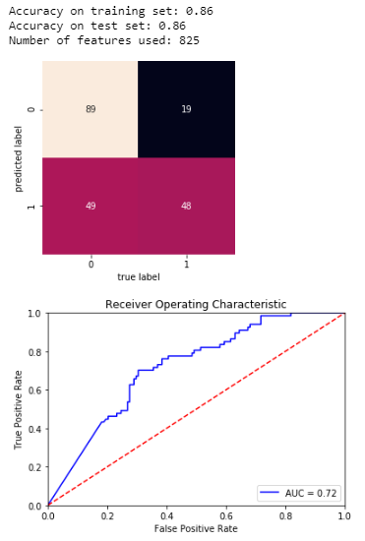
Predictive modelling gaussian naïve-bayes, miner experience

Slide 26
Predictive modelling gaussian naïve-bayes, miner experience

Slide 27
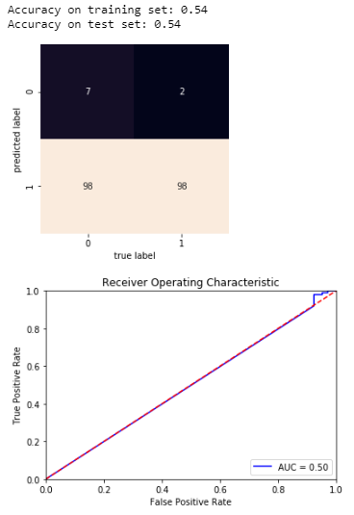
Predictive modelling multinomial naïve-bayes, days lost

Slide 28
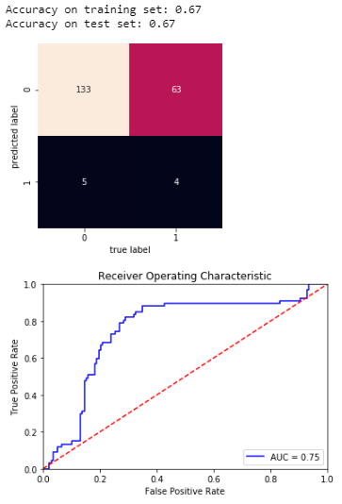
Predictive modelling multinomial naïve-bayes, miner experience

Slide 29

Predictive modelling bernoulli naïve-bayes, days lost

Slide 30
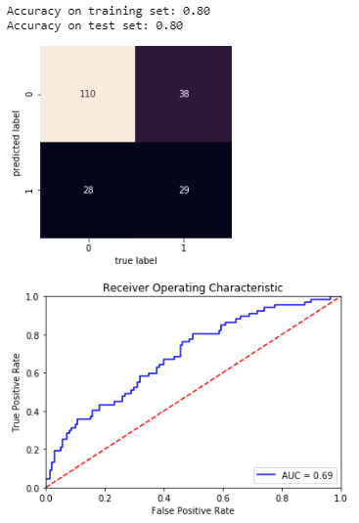
Predictive modelling bernoulli naïve-bayes, miner experience

Slide 31

Predictive modelling SVC, days lost

Slide 32
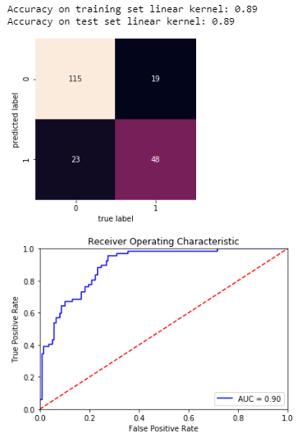
Predictive modelling SVC, miner experience

Slide 33
Predictive model summary
 | Days Lost Train | Days Lost Test | Miner Experience Train | Miner Experience Test
Logistic Regression | 1.00 | 0.97 | 0.93 | 0.79
KNN | 0.75 | 0.55 | 0.81 | 0.63
Simple Tree | 1.00 | 0.97 | 0.92 | 0.81
Random Forest | 1.00 | 0.95 | 0.99 | 0.79
Neural Network | 0.51 | 0.51 | 0.46 | 0.48
Guassian NB | 0.98 | 0.98 | 0.86 | 0.86
Multinomial NB | 0.54 | 0.54 | 0.67 | 0.67
Bernoulli NB | 0.93 | 0.93 | 0.80 | 0.80
SVC (linear) | 0.99 | 0.99 | 0.89 | 0.89

Slide 34



Predictive Modelling Lasso, Ridge and Logistic regression
Lasso
Ridge
Logistic

Slide 35
Future Work
Using TF-IDF for topic selection
Repeat process for underground coal, underground hardrock, and surface hard rock mine types
Compare suspected fatigue reports with non-fatigue
Any differences in the non-narrative fields
Tune the classification models

